Slide 1
Shoot the Moon
2017 North Star Spring Camporee

Slide 2
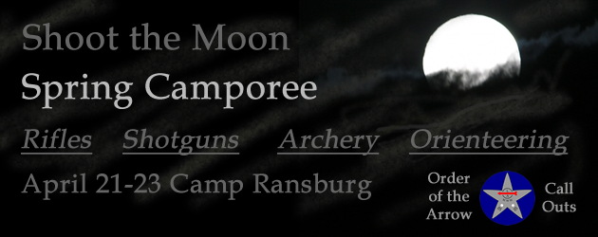

Slide 3
North Star Camporee Committee Mission
Add Sophistication and Planning to Program
Build on Past Camporees
Think Big
  Build Excitement for Scouts
  Increase Attendance

Slide 4


Slide 5
Significant Activities
Shooting Sports
Orienteering
Order of the Arrow Call Outs
Troop Competition
Fellowship

Slide 6
Friday, April 21,2017
Activity
Concerns
Registration 7:00 PM
Set Up Campsite 7:30 PM
Leaders Meeting 8:30 PM
Campfire 9:15 PM
Lights Out 11:00 PM
Registration System & Tracking
Identifying Shooters & Rotations
Need Campfire Program

Slide 7
Saturday, April 22, 2017 Morning
Activity
Concerns
Flags 7:45 AM
Rifles 8:15 AM
Shotguns 8:15 AM
Archery 8:15 AM
Orienteering 8:15 AM
Bag Lunch 11:45 AM
Starting and Staying On-time
Idle Time & Rotations
Hydration
Documentation
Preparing For Willy Inspection
Independent Inspection Team

Slide 8
Saturday, April 22, 2017 Afternoon
Activity
Concerns
Rifles 12:30 PM
Shotguns 12:30 PM
Archery 12:30 PM
Orienteering 12:30 PM
Willy Inspections 3:00 PM
Flags 5:45 PM
Dinner 6:00 PM
OA Call-Outs 8:15 PM
Campfire 9:15 PM
Cracker Barrel 10:15 PM
Lights Out 11:00 PM
Starting On Time
Idle Time & Rotations
Hydration
Documentation
Preparing For Willy Inspection
Independent Inspection Team
Campfire Program
Willy Scoring
Weapons Cleaning & Turn-in
Excess Ammo

Slide 9
Sunday, April 23,2017
Activity
Concerns
Clean-Up 7:30 AM
Scouts Own 8:30 AM
Leaders Meeting 9:30 AM
Closing Remarks 10:15 AM
Departure 11:00 PM
Registration System & Tracking
Identifying Shooters & Rotations
Need Campfire Program

Slide 10
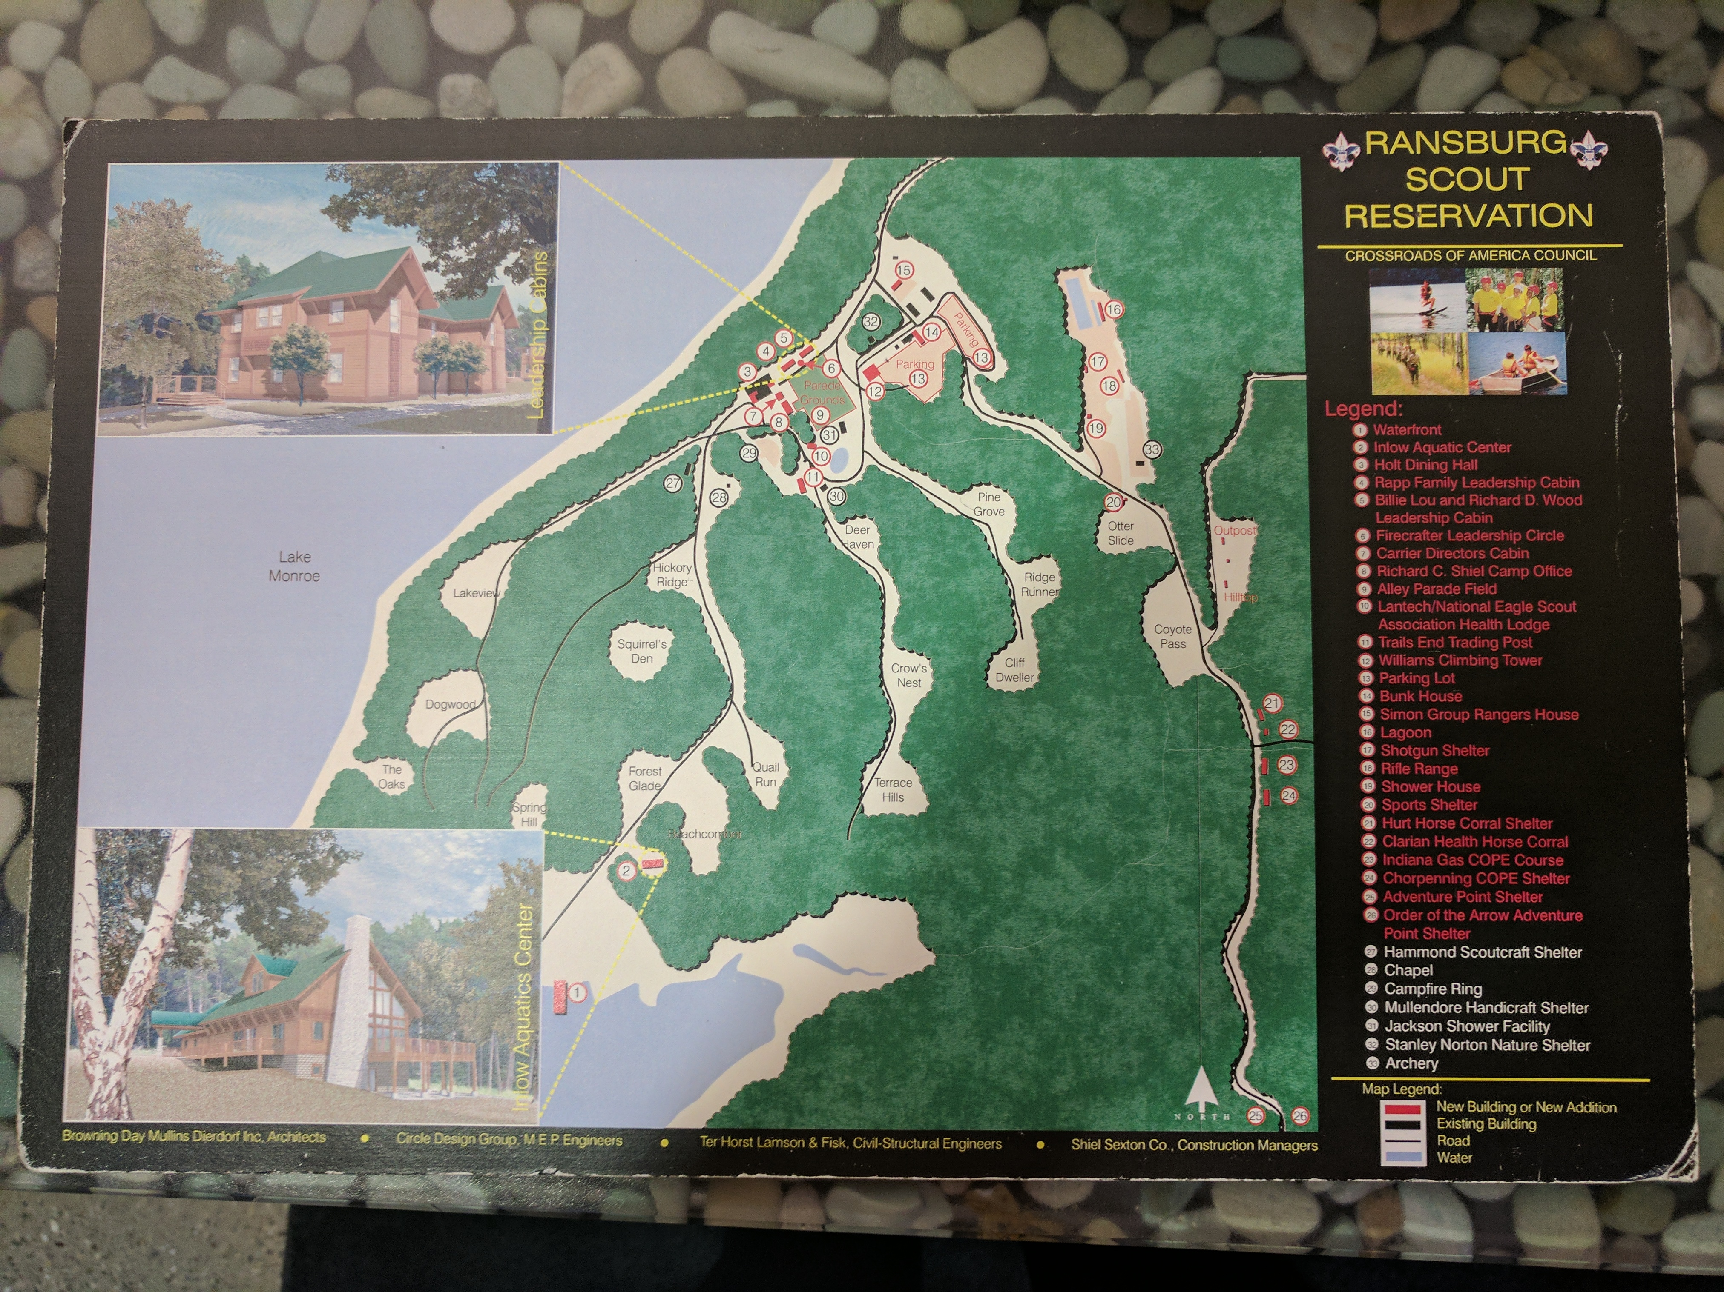

Slide 11
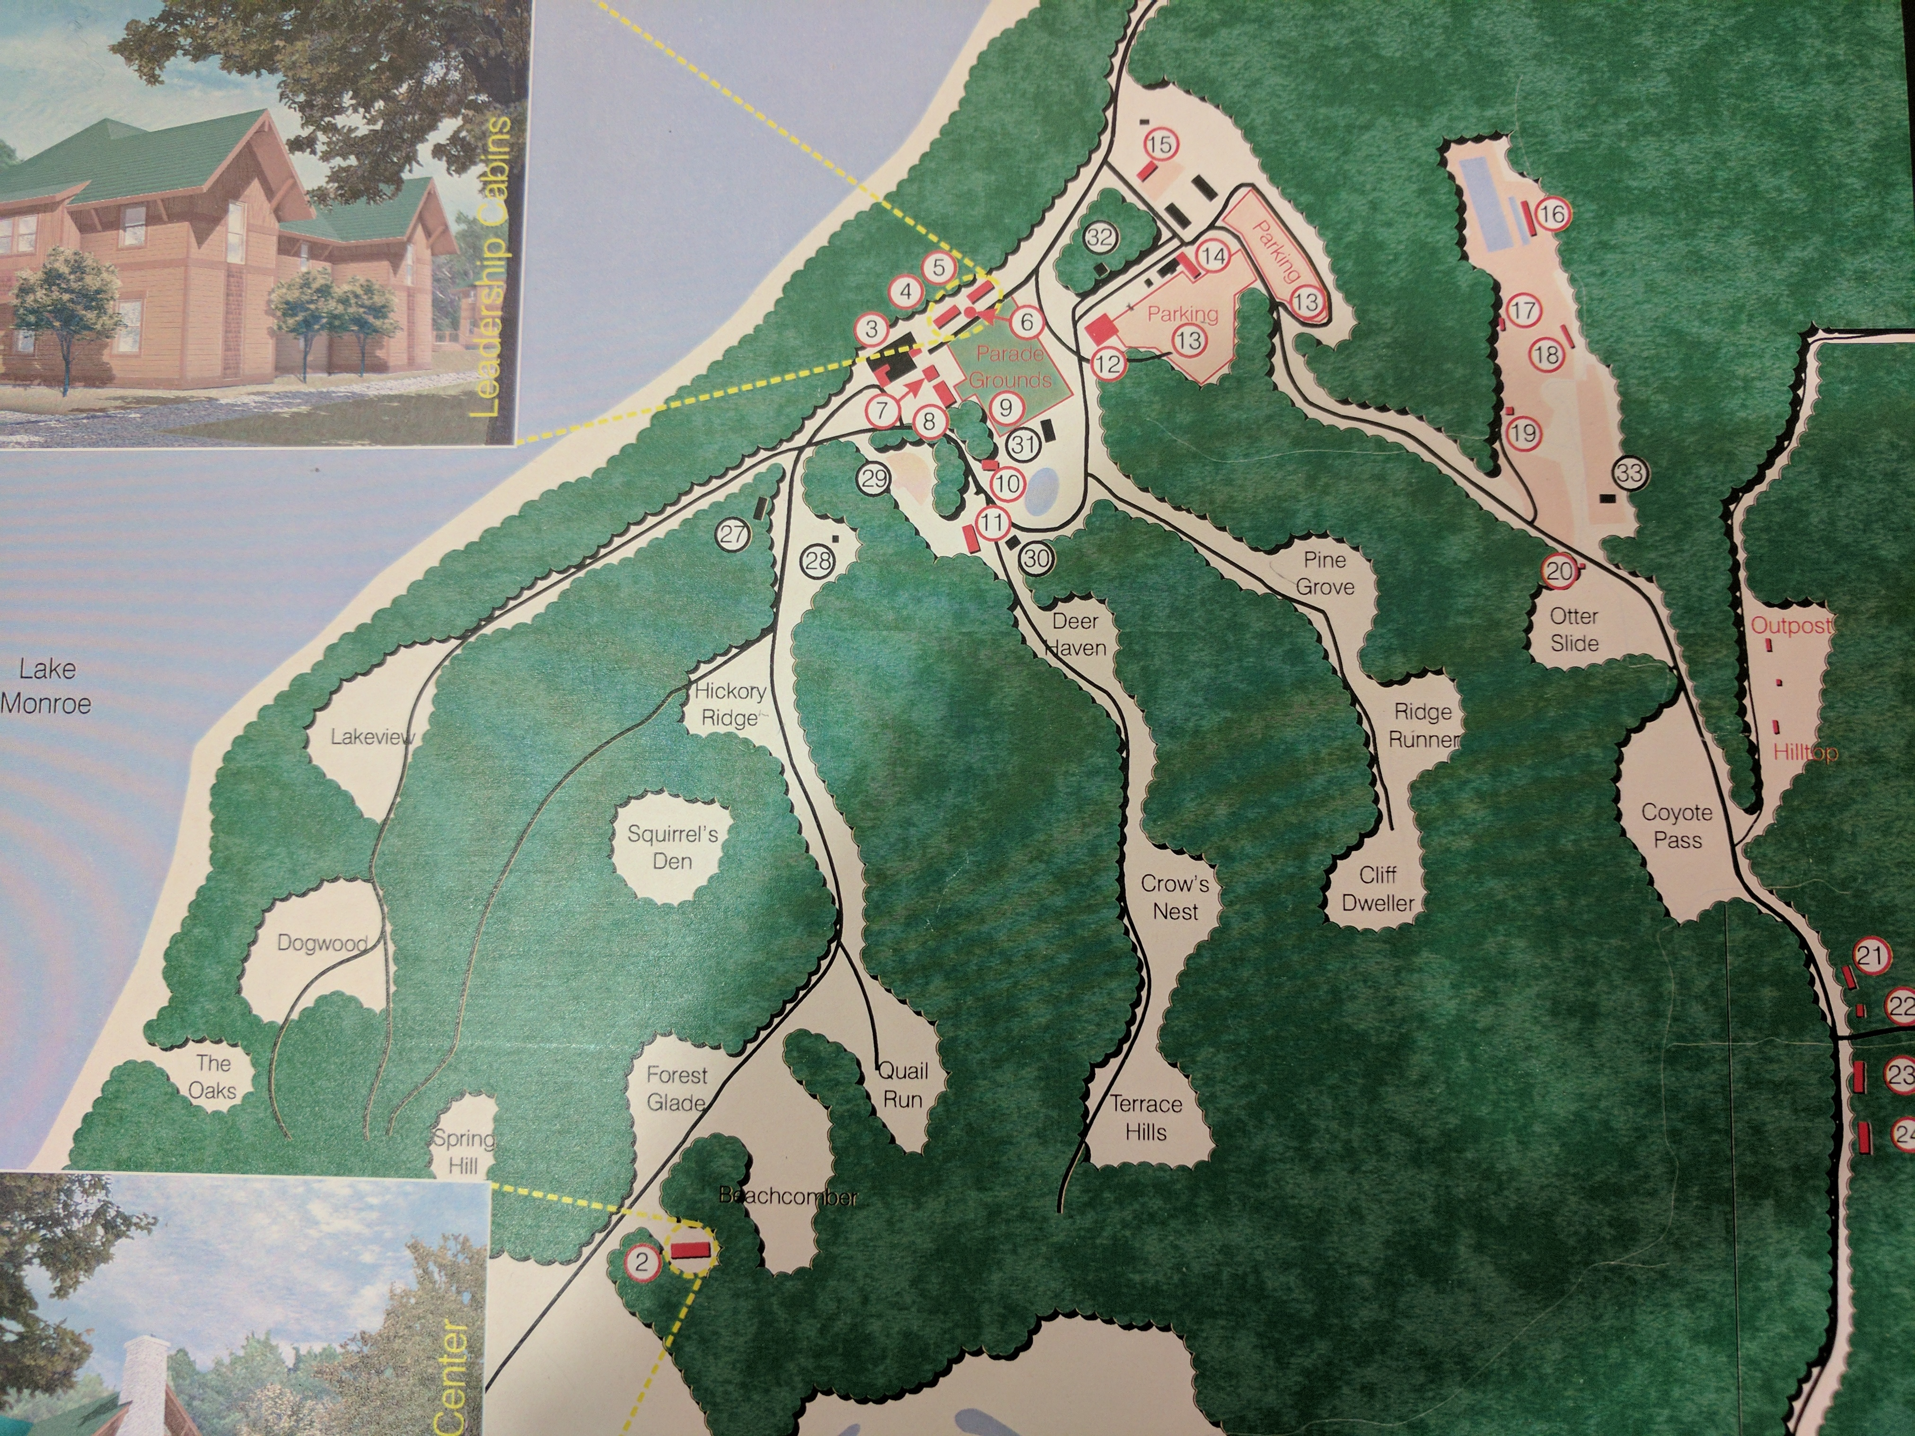

Slide 12
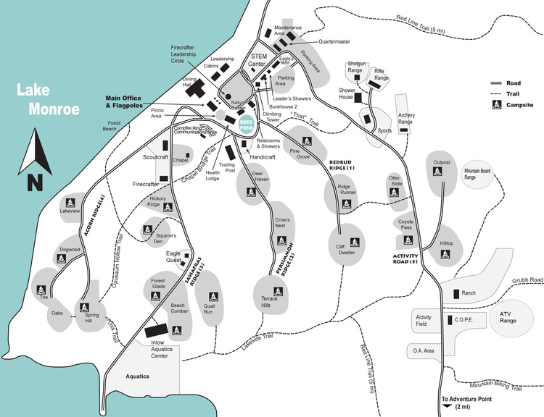

Slide 13
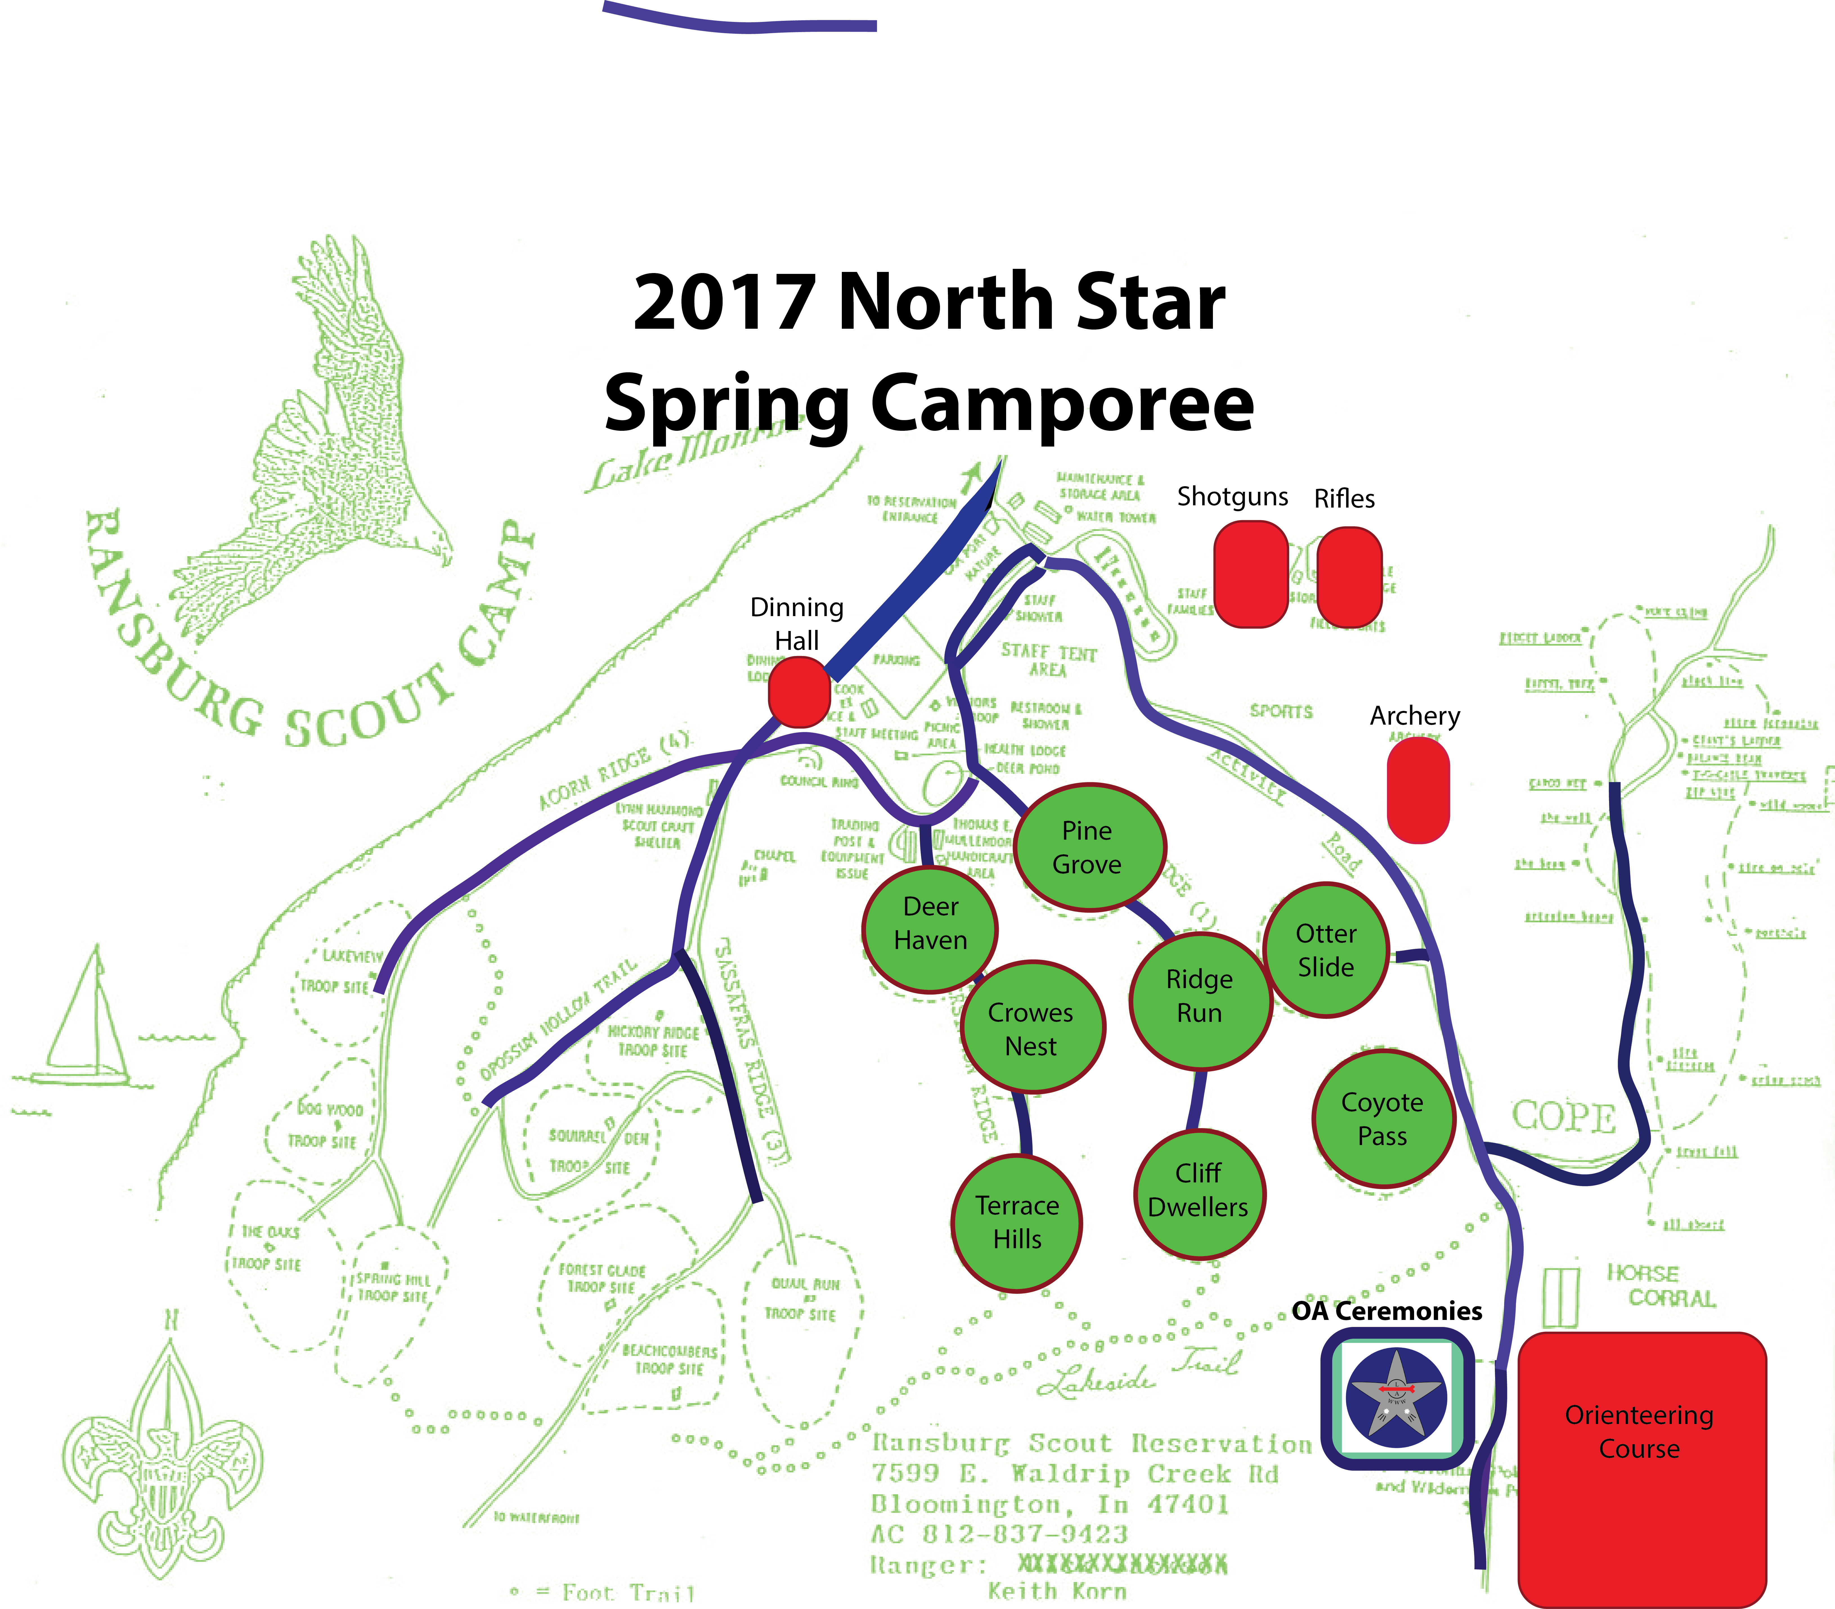

Slide 14
Capacity
Ridge # | Trail | Campsite Name | Capacity |  | Troop Assigned
Activity Road | Activity Road | Otter Slide Left | 24
Activity Road | Activity Road | Otter Slide Right | 24
Activity Road | Activity Road | Coyote Pass Left | 60
Activity Road | Activity Road | Coyote Pass Right | 50
Ridge 1 | Redbud Ridge | Pine Grove Left | 30
Ridge 1 | Redbud Ridge | Pine Grove Right | 30
Ridge 1 | Redbud Ridge | Ridge Runner Left | 24
Ridge 1 | Redbud Ridge | Ridge Runner Right | 24
Ridge 1 | Redbud Ridge | Cliff Dwellers Lower | 24
Ridge 1 | Redbud Ridge | Cliff Dwellers Upper | 24
Ridge 2 | Persimmon Ridge | Deer Haven Left | 30
Ridge 2 | Persimmon Ridge | Deer Haven Right | 30
Ridge 2 | Persimmon Ridge | Crows Nest Back | 24
Ridge 2 | Persimmon Ridge | Crows Nest Front | 24
Ridge 2 | Persimmon Ridge | Terrace Hills Lower | 30
Ridge 2 | Persimmon Ridge | Terrace Hills Upper | 30
Total Capacity |  |  | 482

